Slide 1
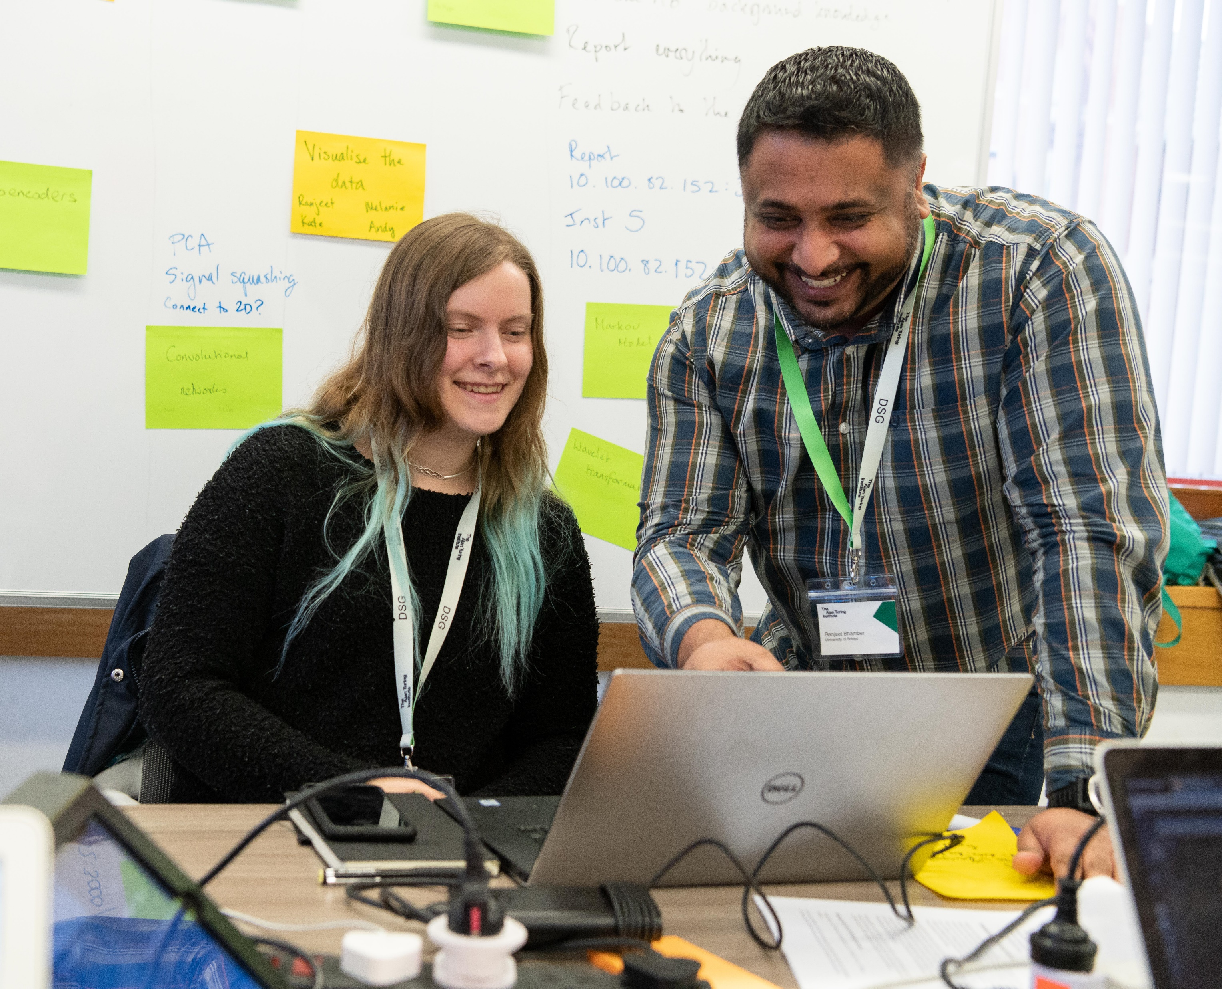
Data Study Group Sensitivity Assessment/ Safe Haven
The national institute for data science and artificial intelligence

Slide 2
The following slides explain the process of assessing the challenge data sensitivity in order to decide what safe haven environment will be used for the project.

Slide 3
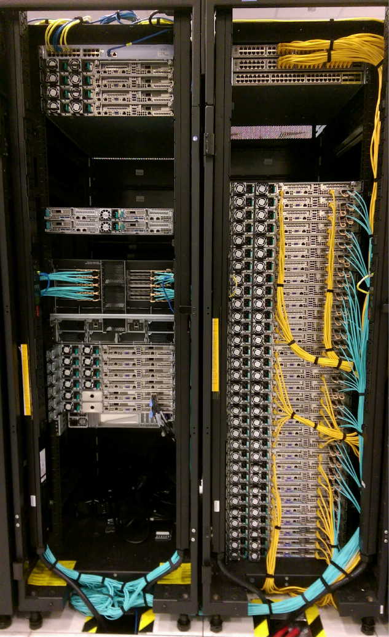
Turing Safe Havens
Secure environments that sit on the Microsoft Azure server
Used to store your data to ensure it is secure for the duration of the project.
Researchers access the environment during the Data Study Group event allowing them to securely work on the challenge.
There all 4 different tiers, each one with different security measures
Projects must be assessed to decide what tier is most appropriate

Slide 4
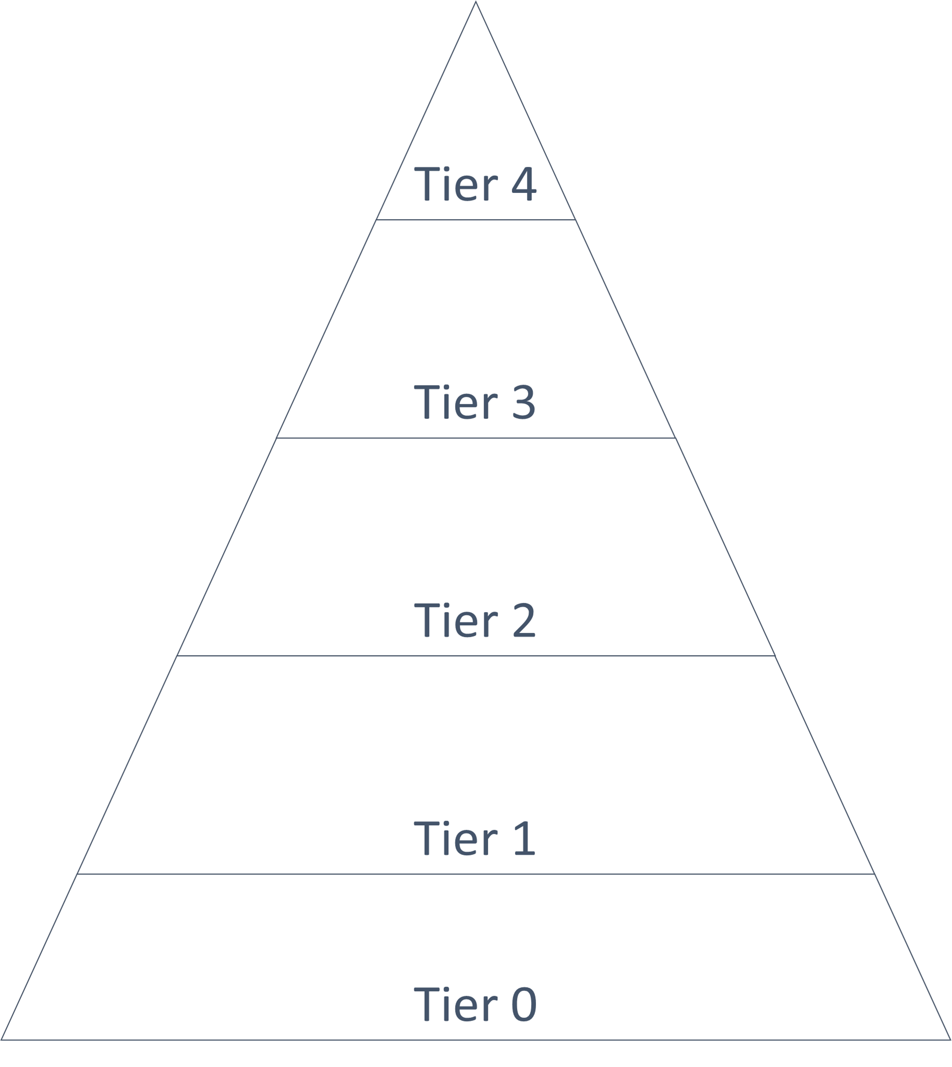
Tier 0/1
Data with very low consequences for disclosure, such as open data
Researchers can use their own devices
Internet access is permitted
Copy and Paste function is permitted

Slide 5
Tier 2
Commercially sensitive data
& strongly pseudonymised personal data
Researchers can use their own devices
No outbound internet
No copy and paste function

Slide 6
Tier 3
Personal data with weak or no pseudonymisation, or more sensitive commercial or government data
Access only from known physical spaces
Access only via managed devices
No internet access
No copy and paste function
White listed packages only

Slide 7
Tier 4
Very sensitive personal, commercial or government data
Access only from know dedicated secure rooms
Stricter package whitelist
The Data Study Group is currently not able to feature tier 4 projects

Slide 8
To assess your projects sensitivity tier:
The challenge owner and PI must separately record their assessment – if they agree the tier is assigned
The Turing has also developed the ‘safe haven web app’ which acts as a digital log for your assessment (instructions to follow)
Whilst looking at the data answer the questions when promoted in the web app and a tier will be generated.

Slide 9
To assess your projects sensitivity tier:
The CO assesses the data using the web app.
The Turing create a new secure environment for the challenge data.
The CO transfers the data to the secure environment.
The PI travels to the Turing to access the secure environment and conduct the assessment.
If the tier 2 or above a referee must also conduct the assessment
The sensitivity tier is assigned and the secure environment amended to reflect the tier security measures.

Slide 10
Transferring your data
There are 2 methods of transferring data into the safe haven
Microsoft Azure Storage Explorer - an upload link emailed securely to you using egress switch. You will need to send us the public IP address of the device that will be used to upload the data.
Physically by bringing your data to the institute on a device.

Slide 11
After the event
Sensitivity assessments are also needed to make sure it is safe to remove anything from the safe haven – including the new documents and images generated by participants during the event.
On the Friday of DSG week COs and PI must inspect the outputs of the week and record their sensitivity in the web app.
If they are a low tier they can be removed so that the PI can finish the report remotely
If they are a high tier (most likely due to commercial sensitivities) the PI might have to access the safe haven each time to work on the report or edits can be made to remove any sensitivities.

Slide 12
Next Steps
If you haven't already complete and return the ‘data sets form’ so we can set your challenge up on the web app.
Use the web app instructions to conduct the assessment of your project/ data
Transfer your challenge data to the Turing so that the PI can start their assessment

